Slide 1

OWN YOUR STACK™
Body · Brain · Business
YOUR STACK · AUTONOMIC
The Nervous System · Going Deeper
Where the Story Deepens
OWN YOUR STACK™ · Menopause & Metabolic Health · saujanyavemuri.com
Notes:
In our last module, Right Woman, Right Time, Right Formulation, we looked at how thoughtful hormone support can give the body what it has been asking for. Today, in the final module of our journey together, we let the story deepen by returning to where it all begins, the nervous system. Because underneath the food, the movement, the sleep, and the hormones, there is a quieter system setting the tone for all of it, the autonomic nervous system that decides, moment to moment, whether the body feels safe enough to heal. So the question we want to sit with today is not how do we push harder through this transition, but rather how do we help the body feel safe enough to change. Today, I want to talk with you about what it really means to coach yourself and women around you through the transition of menopause. To guide this, I will share my screen so we can walk through this material together. Coaching a woman through the transition of menopause isn't just about symptoms or survival. It's about helping a woman understand what is happening to her. It's about validating her feelings. It's about teaching her tools to support her. All of these actions require a pause. So I like to flip the no in menopause upside down. I like to think of it as me on pause, because I believe it is an opportunity for a woman to pause, reflect, reset, and step into a new version of themselves, and coaching is a bridge that can help them get there.

Slide 2

OWN YOUR STACK™
saujanyavemuri.com
Body · Brain · Business
THREE NERVOUS SYSTEM STATES
Validation
through a
polyvagal
lens.
Polyvagal theory explains why our nervous system responses shift in menopause.
VENTRAL VAGAL
SYMPATHETIC
DORSAL
Safety, calm, and social connection. Our optimal state.
Fight-or-flight: anxiety, irritability, hypervigilance.
Shutdown: fatigue, fogginess, withdrawal, disconnection.
Hormonal changes cause us to get stuck in defensive states — this is biology we can work with.
OWN YOUR STACK™ · Menopause & Metabolic Health · saujanyavemuri.com
Notes:
We've seen how critical it is for a woman in menopause to understand what's happening in her body and brain. But knowledge alone doesn't quiet the storm. When cortisol is high and the buffers of estrogen and progesterone are gone, her nervous system may be stuck in overdrive. In that state, peace feels out of reach and real work can't begin. And this is why when we work with a woman who is going through menopause, we must work on validation. This becomes the very first step. It becomes essential. Before strategy, before tools, before change, we meet her exactly where she is. When going through menopause, most women hear comments like, "It's just aging. Tough it out." That dismissal deepens their suffering. Validation changes everything, and here polyvagal theory gives us a framework. Stephen Porges's model describes three main states of the nervous system. The ventral vagal state is safety. It is when you feel calm, social, and connected. The sympathetic state is when you are in fight or flight. You feel anxious, irritable, on edge, or other strong emotions. The dorsal state is when you feel shut down, fatigued, foggy, or withdrawn. People oscillate between these three states, moving down to the sympathetic state or even down to the dorsal state when danger is sensed. Moving back up to the ventral vagal when they feel safe.

Slide 3

OWN YOUR STACK™
saujanyavemuri.com
Body · Brain · Business
NEUROBIOLOGICAL REALITY
The tendency
to stay
defensive.
Hormone decline makes it easier to shift into survival nervous system states.
Hot flashes can trigger panic and sympathetic fight-or-flight responses.
Sleepless nights may cause dorsal shutdown, fatigue, and withdrawal.
Emotional volatility reflects neurobiological changes — not who we are.
OWN YOUR STACK™ · Menopause & Metabolic Health · saujanyavemuri.com
Notes:
This movement is normal, but without hormones supporting the menopausal woman, she can become stuck in a defensive state much more easily. In reproductive years, estrogen and progesterone help women stay anchored in the ventral state by helping her to feel safe and calm. But when these hormones fade, women tip more easily into survival states. Hot flashes might feel like panic and can trigger a sympathetic surge, leading her to fight or flee. Many sleepless nights could slide her into dorsal fatigue, shut down, and unable to open up. Emotional volatility is not imagined. It is neurobiology. Once a woman finds herself in a defensive state, it becomes harder to find safety. It becomes harder to listen. It becomes harder not to put herself down. It becomes harder not to feel shame.

Slide 4

OWN YOUR STACK™
saujanyavemuri.com
Body · Brain · Business
COACHING & LANGUAGE
The power
of words.
The right words lift shame and reduce self-blame.
Understanding that our body is in a heightened safety-seeking state is empowering, not limiting.
Knowledge gives us language and language gives us power to support our nervous system.
OWN YOUR STACK™ · Menopause & Metabolic Health · saujanyavemuri.com
Notes:
So the coach's words can truly help. When a coach looks at a woman and says, "This isn't weakness, this is your nervous system responding without its usual hormonal support. It is happening to you." Then the shame begins to lift. She stops blaming herself. She begins to see her emotions, not as personal flaws, but as states her body is moving through. She also starts to see that her body senses danger more easily. With this knowledge, she can learn tools to help support her own nervous system so that her body can read a situation as safe. We will review some of these later. Finally, another part of the validation process is helping a woman educate her loved ones so that she can also receive validation from them.

Slide 5

OWN YOUR STACK™
saujanyavemuri.com
Body · Brain · Business
FAMILY AND RELATIONSHIPS
Social
support
changes
everything.
Education about menopause transforms misunderstanding into empathy.
Awareness helps our loved ones see symptoms as biological.
Compassion and patience grow with knowledge of hormonal changes.
Families can offer practical support: space, shared responsibilities, listening.
Open conversations replace conflict with connection and healing.
OWN YOUR STACK™ · Menopause & Metabolic Health · saujanyavemuri.com
Notes:
We are going to explore why educating support systems is also essential while working with women going through menopause. Why does her family need education? Partners and children often take symptoms personally. Irritability can feel like rejection. Forgetfulness can feel like carelessness. But when they understand the science, the story changes. Education fosters empathy. Loved ones begin to see this as biology, not neglect. With that awareness, compassion grows, and patience follows. Knowledge also helps families offer practical support, whether that means giving space on a hard day, stepping in with chores, or simply listening without judgment. Most importantly, education strengthens relationships. Open conversations about menopause replace conflict with connection and create the supportive family atmosphere that women need to regulate and heal.

Slide 6
OWN YOUR STACK™
saujanyavemuri.com
Body · Brain · Business
THE COMMUNITY DIMENSION
Community
support
transforms.
Menopause often goes unacknowledged in workplaces and social settings.
Lack of education leads to silence, stigma, and isolation ,all of which compound the experience.
Informed communities foster empathy, open conversations, and real support.
OWN YOUR STACK™ · Menopause & Metabolic Health · saujanyavemuri.com
Notes:
Communities also need education. Menopause is rarely acknowledged at work or in social spaces, yet half the population goes through it. Without education, silence turns into stigma, leaving women isolated and misunderstood. When communities are informed, empathy grows, conversations open, and the workplace becomes a safer place to speak, and judgment begins to fade. Informed employers can create supportive environments, from flexible schedules to cooler office spaces, easing symptoms and reducing stress. Education doesn't just inform communities, it transforms them into places where women feel seen, supported, and respected. The bottom line is education is power. It is not optional. It is the difference between shame and dignity, isolation and connection.

Slide 7

OWN YOUR STACK™
saujanyavemuri.com
Body · Brain · Business
THE MIDLIFE INTERSECTION
Reassessing
priorities.
The menopause transition is a significant life recalibration.
It intersects with career demands, caregiving, and shifting family dynamics.
Stress becomes the primary amplifier of menopausal symptoms.
Hormonal changes increase our sensitivity to stress . Our threshold shifts.
Stress management is not optional during this transition . It is foundational.
OWN YOUR STACK™ · Menopause & Metabolic Health · saujanyavemuri.com
Notes:
We've seen how education gives her understanding and how validation gives her safety. But even with those in place, many women are still running on empty, pulled in every direction by family, work, and expectation. This is why the next step is so important, reassessing priorities. In this stage of life, the priority can no longer be everyone else first. It has to shift. The priority needs to be herself. Menopause is not just a biological transition. It is a life transition. It collides with the time when women have careers, when they are caregivers, when they have aging parents, when they have children leaving home, and it collides with cultural narratives about aging. For decades, women have been trained to put everyone else first. But menopause is the point where that strategy collapses. Stress is no longer background noise. It becomes the main driver of symptoms. And stress doesn't just show up because of menopause. It also worsens it. Heightened stress magnifies hot flashes, deepens insomnia, sharpens irritability, and accelerates hormonal imbalance. In turn, hormonal shifts make women more sensitive to stress. It's a feedback loop that leaves many feeling trapped. This is why stress management is not optional. It is essential. It is the key to easing symptoms, restoring hormonal balance, and reclaiming well-being in this stage of life. This is the heart of reassessment, helping women recognize that stress management is now their number one health priority. Not a side project, not an afterthought, not something to do when you have time. It's got to be the foundation. If cortisol stays unchecked, every other strategy falters: nutrition, exercise, sleep, even medication. Stress must be addressed directly.

Slide 8

OWN YOUR STACK™
saujanyavemuri.com
Body · Brain · Business
REDEFINING SELF-CARE
Self-care
is not
optional.
Chronic stress can no longer be managed by diet or exercise alone.
Rest is vital. Not indulgent. A biological necessity.
Self-care routines improve mood stability and build genuine resilience.
Stress reduction is the foundation everything else is built on.
Prioritising self-care empowers us to reclaim our well-being and our relationships.
OWN YOUR STACK™ · Menopause & Metabolic Health · saujanyavemuri.com
Notes:
Diet and exercise are vital for health and resilience, but on their own, they cannot overcome the effects of unrelieved stress. Unmanaged cortisol undercuts their benefits, draining energy, disrupting sleep, and amplifying cravings. This is why a holistic approach is essential. Addressing stress alongside nutrition and movement restores balance across the whole system. When stress is managed, diet works better, exercise strengthens more effectively, and overall well-being rises. Dr. Mindy Pelz reinforces this truth. She calls menopause a rewiring of the female body and brain, a time when cortisol rises louder and faster because estrogen and progesterone are no longer buffering it. What once was manageable now feels overwhelming because the biology has changed. She reminds us, "You can't out-diet or out-exercise chronic stress." Pelz also reframes menopause as an invitation. Instead of pushing through, women can use this stage to redefine priorities — me on pause. Stress reduction isn't an indulgence, it's survival, and at the heart of that is rest. Adequate rest is not laziness, it is medicine. It restores both physical and emotional well-being, giving the nervous system space to reset. Self-care practices become essential. Simple routines steady mood and rebuild resilience. These practices are not extras. They are foundational. Stress reduction techniques bring the body back into balance. Reassessment then is about giving women permission to put themselves at the center, to see stress management, rest, and self-care not as selfish, but as the groundwork for everything else. Nutrition works better, sleep deepens, energy steadies, relationships heal, and life opens back up.

Slide 9

OWN YOUR STACK™
saujanyavemuri.com
Body · Brain · Business
THREE CATEGORIES OF TOOLS
Tools for
the pause.
We have tools. And they work.
NERVOUS SYSTEM
Regulate stress and promote calm.
EMOTIONAL
Process and manage mood shifts with compassion.
LIFESTYLE
Enhance hormonal balance through how we live.
OWN YOUR STACK™ · Menopause & Metabolic Health · saujanyavemuri.com
Notes:
So we've talked now about what's happening in her body and brain. Now we're going to focus on what she can actually do about it. The tools ahead fall into three groups: nervous system tools, emotional tools, and lifestyle tools.

Slide 10

OWN YOUR STACK™
saujanyavemuri.com
Body · Brain · Business
FOUR SELF-REGULATION PRACTICES
Nervous
system
tools.
Arm Tracing
Signals safety to the nervous system when stressed or in shutdown.
Neck Release
Targets the SCM muscle to ease tension and stimulate vagal pathways.
Grounded Breathing
Combines breath with grounding while signalling safety to the body.
Orienting Practice
Helps our nervous system actively recognise that we are safe right now.
OWN YOUR STACK™ · Menopause & Metabolic Health · saujanyavemuri.com
Notes:
These four practices are things we can come back to again and again — not just in a session, but in the middle of a hard day, a sleepless night, or a moment when everything feels like too much.
The first is Arm Tracing. When we are stressed or in shutdown, our nervous system has lost its sense of safety. Simply tracing our own arm — slowly, with intention — sends a signal that we are here, we are present, we are not in danger. It sounds almost too simple. It works because the body responds to touch before the mind has time to argue.
The Neck Release targets the sternocleidomastoid muscle — that long muscle running down the side of the neck. It connects directly to vagal pathways, which means releasing tension there actually helps downregulate our stress response. Gentle is enough.
Grounded Breathing is breath paired with body contact — feeling the floor beneath our feet while we breathe slowly. We are combining two signals at once: the breath tells the brain to slow down, and the ground tells the body it is held.
And finally, the Orienting Practice — this is simply letting our eyes move around the room, slowly, taking in what is actually here. Our nervous system is actively scanning for threat all the time. When we deliberately look around and see that we are safe, we give it permission to settle. It is one of the most underrated tools we have.

Slide 11

OWN YOUR STACK™
saujanyavemuri.com
Body · Brain · Business
EIGHT PRACTICES
Emotional
tools for
menopause.
Name the Feeling
Separate Self from Hormones
Reduce emotional intensity and gain clarity.
Reduce self-blame.
Scan the Body
Anchoring Statements
Connect emotions to physical sensations.
Provide stability in difficult moments.
Give Permission
Rewrite the Story
Lower guilt and shame.
Shift identity and narrative.
Grief Ritual
Circles and Community
Honor what has been lost or changed.
Create connection and shared understanding.
OWN YOUR STACK™ · Menopause & Metabolic Health · saujanyavemuri.com
Notes:
me the Feeling — research consistently shows that labelling an emotion reduces its intensity. When we say "I feel angry right now," the amygdala calms. It is not about analysing the feeling. It is just about seeing it clearly.
Separate Self from Hormones is one of the most liberating reframes we offer. That inner critic who showed up at 2am? That is not our truth. That is a hormonal pattern. We are not our worst perimenopausal moment.
Scan the Body helps us notice where emotion lives physically — the tight chest, the clenched jaw — so we can work with it directly.
Anchoring Statements are short, true phrases we return to when we feel destabilised. "I have navigated hard things before." "This is temporary."
Give Permission is about releasing guilt — for resting, for changing, for not being who we were a decade ago.
Rewrite the Story invites us to step back from an old narrative and ask whether it still serves us.
Grief Ritual honours what menopause takes — our fertility, sometimes our identity, sometimes relationships that no longer fit. Grief is not pathology. It is love moving through a transition.
And Circles and Community — because healing happens in connection. We were never meant to do this alone.

Slide 12
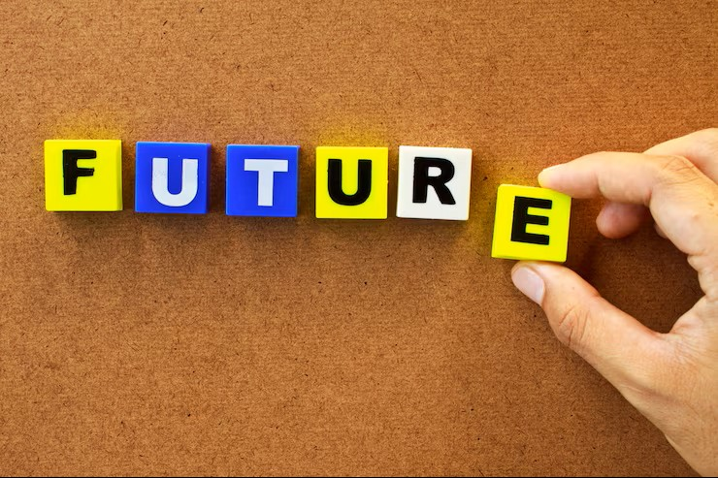
OWN YOUR STACK™
saujanyavemuri.com
Body · Brain · Business
COACHING REFLECTION QUESTIONS
How does Future You carry herself in the world?
Picture
a future
you.
What is one small choice today that Future You will celebrate?
When you picture yourself at peace, what did you stop doing to get there?
What would Future You say to encourage you right now?
What boundaries has she set — and kept?
What joy has she made room for?
OWN YOUR STACK™ · Menopause & Metabolic Health · saujanyavemuri.com
Notes:
This is one of our favourite moments in any session, because it shifts the question from "what is wrong with me right now" to "who am I becoming."
Future You is not a fantasy. She is a direction. She is the version of you who has moved through this transition with intention — who made choices, even small ones, that added up to something real.
So let us sit with these questions. You do not have to answer them out loud. Just let them land.
How does Future You carry herself in the world? Not perform — carry. There is a difference.
What is one small choice today that Future You would celebrate? Not a massive overhaul. One thing.
When you picture yourself at peace — what did you stop doing to get there? That one is worth writing down.
What would Future You say to you right now? What encouragement would she offer?
What boundaries has she set — and actually kept?
And finally — what joy has she made room for?
These questions are not about pressure. They are about possibility. They are an invitation to remember that menopause is not where the story ends. It is where it deepens.

Slide 13
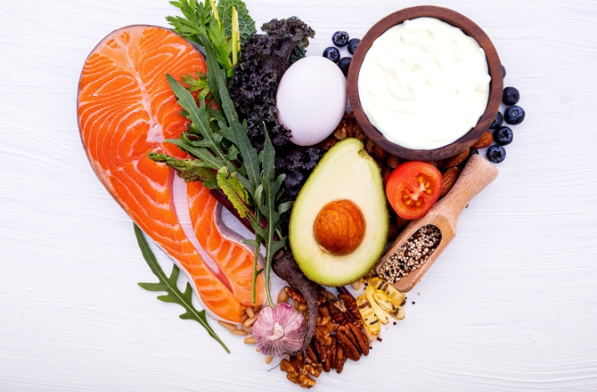
OWN YOUR STACK™
saujanyavemuri.com
Body · Brain · Business
WHAT WE EAT CHANGES EVERYTHING
Low-carbohydrate eating stabilises our blood sugar and reduces insulin spikes.
Nutrition
as medicine.
Ketones provide an alternative brain fuel particularly valuable when oestrogen-driven glucose metabolism declines.
Ketones protect neurons and reduce oxidative stress in the brain.
Reducing insulin lowers inflammation easing joint pain, improving mood, and clearing brain fog.
OWN YOUR STACK™ · Menopause & Metabolic Health · saujanyavemuri.com
Notes:
Food is information. Every meal we eat sends a signal to our hormones, our brain, our metabolic system. And during menopause, that signal matters more than it ever has before.
When oestrogen declines, our cells become less efficient at using glucose as fuel. The brain, which is an extraordinarily energy-hungry organ, starts to feel that shift — and that is where the brain fog, the fatigue, and the mood instability often come from. It is not in our heads. It is in our metabolism.
Low-carbohydrate eating stabilises our blood sugar and reduces the insulin spikes that drive fat storage, inflammation, and hormonal disruption. We are not talking about restriction or punishment. We are talking about becoming strategic about the fuel we give our bodies.
Ketones — produced when we lower carbohydrate intake — offer an alternative fuel source that the menopausal brain actually prefers. Studies show they provide more stable, efficient energy than glucose for many women in this transition.
They also protect neurons and reduce oxidative stress in the brain. That matters enormously for long-term cognitive health.
And when we lower insulin, we lower inflammation — which means less joint pain, clearer thinking, more stable mood. These are not small benefits. This is nutrition as medicine. And it is something we can actually control. I want to put one more voice alongside this, because Dr. Robert Lustig makes the point so memorably in his book Metabolical. His phrase is that metabolic dysfunction is, in his words, not drugable, it is foodable, which is to say the deepest leverage we have sits on the end of our fork, not in a prescription. That is exactly what this slide is about. When we choose the fuel that lowers insulin and steadies our energy, we are not just easing a symptom, we are addressing the root. Food really is information, and in this season of life it may be the most powerful and the most available medicine we have.

Slide 14

OWN YOUR STACK™
saujanyavemuri.com
Body · Brain · Business
THE SLEEP IMPERATIVE
Sleep is essential for hormone repair, tissue restoration, and metabolic detoxification.
Sleep as
vital
medicine.
Lack of sleep increases cortisol and worsens insulin resistance ; a compounding cycle.
We are especially vulnerable to sleep loss effects during the menopausal transition.
Poor sleep impairs mood regulation and cognitive function .The consequences are real and measurable.
OWN YOUR STACK™ · Menopause & Metabolic Health · saujanyavemuri.com
Notes:
If there is one thing we could say to every woman navigating menopause, it is this: sleep is not a luxury. It is not something to push through or manage with caffeine. It is the foundation everything else rests on.
While we sleep, our body is doing extraordinary work. Hormones are being repaired and regulated. Tissues are being restored. The brain is clearing metabolic waste through the glymphatic system. Every single system in our body depends on adequate, quality sleep to function.
When sleep is disrupted — and during the menopausal transition, it so often is — our cortisol rises. Elevated cortisol worsens insulin resistance, which worsens hormonal chaos, which worsens sleep. We are in a cycle that compounds itself night after night.
We are also particularly vulnerable to these effects during perimenopause and menopause because oestrogen and progesterone — both of which support sleep architecture — are declining. The hot flashes, the night sweats, the racing mind at 3am — these are not personal failings. They are biology.
And the downstream effects are real and measurable: mood dysregulation, impaired memory, reduced executive function, increased metabolic risk. This is why we treat sleep as one of our non-negotiable pillars.

Slide 15

OWN YOUR STACK™
saujanyavemuri.com
Body · Brain · Business
FIVE EVIDENCE-BASED APPROACHES
Consistent sleep and wake times anchor our circadian rhythm.
Sleep
Strategies to explore.
Morning light exposure . The single most powerful circadian signal we have.
A cool sleeping environment ,core body temperature must drop for deep sleep.
Bedtime rituals signals safety and downshift to our nervous system.
Strategic short naps to recover from sleepless nights without disrupting the next night.
OWN YOUR STACK™ · Menopause & Metabolic Health · saujanyavemuri.com
Notes:
he good news is that sleep is highly responsive to strategy. We do not have to accept disrupted nights as the new normal. These five approaches are grounded in the science of circadian biology and nervous system regulation, and all of them are within our reach.
Consistent sleep and wake times are the single most powerful anchor for our circadian rhythm. Even on weekends. Even after a poor night. The consistency is what trains our system.
Morning light exposure is the most powerful circadian signal we have. Within thirty minutes of waking, getting outside — even on a cloudy day — tells our brain clock to start counting toward sleep that night. It is free, and it works.
A cool sleeping environment matters more than most people realise. Our core body temperature must drop by one to two degrees to initiate deep sleep. Keeping the bedroom cool — around 65 to 68 degrees Fahrenheit — supports that drop.
Bedtime rituals signal to our nervous system that the day is closing and safety is established. Dimming lights, gentle movement, a warm bath, even a few minutes of journaling — these are not indulgences. They are neurological cues.
And strategic short naps — twenty minutes, before 2pm — can help us recover from a disrupted night without interfering with the next one. The key word is strategic. We are working with our biology, not against it.

Slide 16
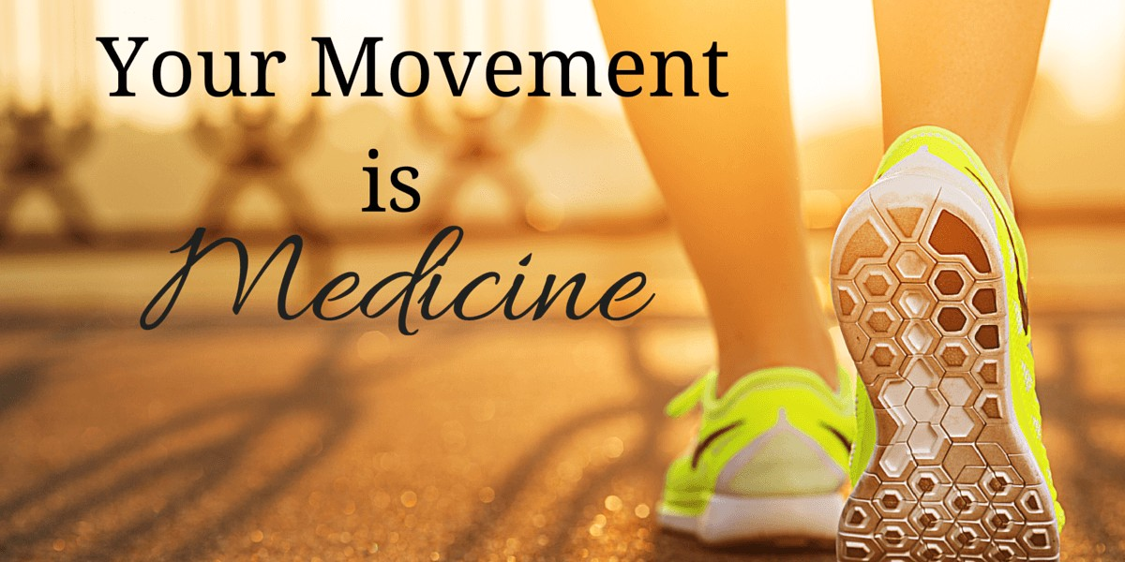
OWN YOUR STACK™
saujanyavemuri.com
Body · Brain · Business
EXERCISE & THE MENOPAUSAL BODY
Movement regulates blood sugar, mood, hormones, and our stress response.
Movement
as medicine.
Exercise does not need to be intense. It can be simple, brief, and integrated into daily life.
Short strength sessions and daily movement preserve our muscle mass and bone density.
Exercise improves insulin sensitivity significantly, lowering our metabolic disorder risk.
OWN YOUR STACK™ · Menopause & Metabolic Health · saujanyavemuri.com
Notes:
Movement is one of the most powerful tools we have during this transition — and one of the most misunderstood.
We are not talking about punishing workouts or hours on a treadmill trying to offset what we ate. We are talking about strategic, intentional movement that speaks directly to what our menopausal body needs.
Movement regulates blood sugar, mood, hormones, and our stress response — all in a single session. A twenty-minute walk after a meal can lower post-meal glucose significantly. A strength session can shift our cortisol pattern for hours. Movement is metabolic medicine.
And here is what we want every woman to hear: it does not need to be intense to be effective. Brief, consistent, integrated into daily life — that is the model we want to build. Ten minutes of resistance work, a walk at lunch, stretching in the evening. Compound that across a week, and the benefits are profound.
Short strength sessions are particularly important because from our mid-forties onward, we begin losing muscle mass at an accelerating rate if we do not actively counter it. Muscle is not just about aesthetics. It is our metabolic engine. It protects our bones. It gives us energy.
And exercise — particularly resistance training — dramatically improves insulin sensitivity, which lowers our metabolic disorder risk at a time when that risk is rising. We are investing in our future health every time we move. We want to close with this — and we mean it with everything we have.

Slide 17

OWN YOUR STACK™
saujanyavemuri.com
Body · Brain · Business
THE CLOSING PERSPECTIVE
Menopause marks a biological reset ,a new chapter, not an ending.
Menopause
as a gateway
to renewal.
Pausing allows us to understand and honour our changing bodies.
Reassessment during menopause leads to resilience, clarity, and self-knowledge.
This transition brings an extraordinary opportunity for reprioritisation and renewal.
OWN YOUR STACK™ · Menopause & Metabolic Health · saujanyavemuri.com
Notes:
Menopause is not the beginning of decline. It is a biological reset. It is the body saying: we are changing direction. And while that can feel disorienting, even frightening in the middle of it — it carries within it an extraordinary invitation.
When we pause — when we actually stop and look honestly at what this transition is asking of us — we gain something rare. We gain the chance to understand and honour our changing body rather than fight it. To stop living by rules that were written for a version of ourselves that no longer exists.
The women who move through menopause with the most resilience are not the ones who resist it. They are the ones who get curious. Who reassess. Who allow the transition to reveal what actually matters.
Reassessment during menopause leads to resilience, clarity, and a quality of self-knowledge that simply was not available to us before. We know what we can tolerate. We know what we cannot. We know who we are when things are hard.
And this transition — with all of its challenge, all of its upheaval — brings with it an extraordinary opportunity for reprioritisation and renewal. To build a life, a body, and a sense of self that is not just surviving menopause but genuinely thriving through it and beyond.
That is what we are here to help build together.

Slide 18
OWN YOUR STACK™
Try This Week
saujanyavemuri.com
Body · Brain · Business
YOUR MICRO-EXPERIMENT · AUTONOMIC
Give the body one cue of safety a day
This week, pick one of the four practices and use it once a day, especially in the moments the storm rises. You are teaching the nervous system, in real time, that it is safe.
Arm Tracing answer stress with slow, gentle touch along the arm.
Neck Release ease the SCM muscle to stimulate the vagal pathway.
Grounded Breathing pair each breath with the feeling of contact and weight.
Orienting let the eyes slowly scan the room and confirm you are safe right now.
Validation comes first, regulation comes next. At the end of the week, write one line on which practice your body answered to, and why.
Menopause & Metabolic Health · saujanyavemuri.com
Notes:
Before we close, here is your experiment for the week, and it is a gentle one. This week, pick just one of the four practices on this slide and use it once a day, especially in the moments when the storm rises. You might choose arm tracing, answering stress with slow, gentle touch along the arm. You might choose the neck release, easing the muscle that runs along the side of the neck to stimulate the vagal pathway. You might choose grounded breathing, pairing each breath with the feeling of contact and weight. Or you might choose orienting, letting your eyes slowly scan the room to confirm that you are safe right now. Whichever one you pick, you are teaching the nervous system, in real time, that it is safe. Remember the order, validation comes first, and regulation comes next. At the end of the week, write one line on which practice your body answered to, and why. That single sentence is you learning the language of your own nervous system.

Slide 19
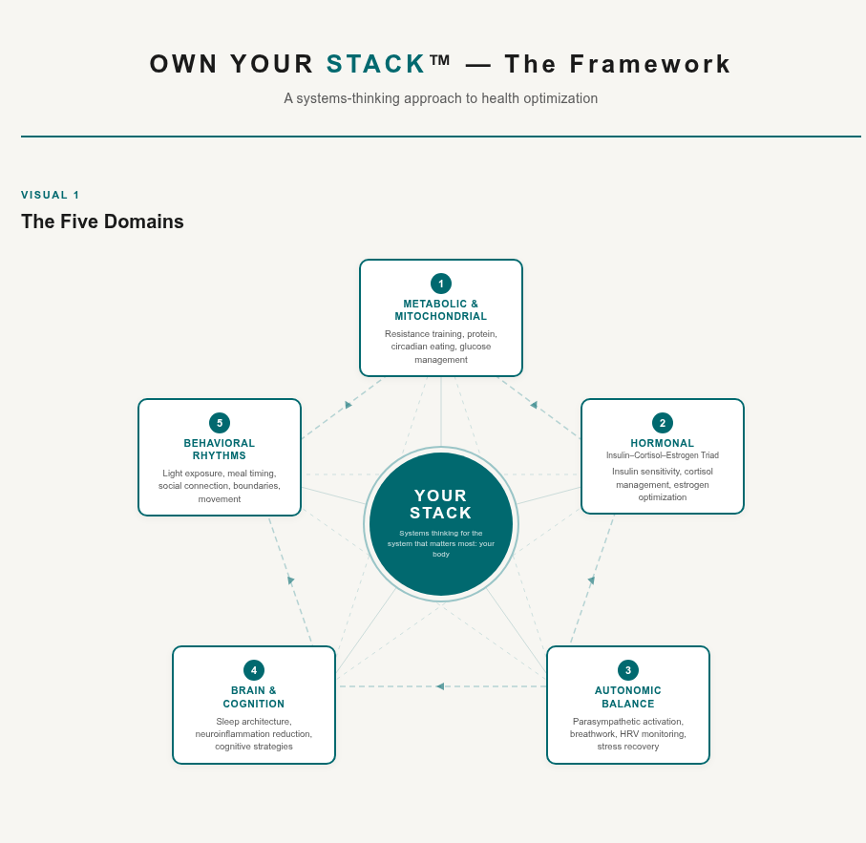
OWN YOUR STACK™
saujanyavemuri.com
Body · Brain · Business
1
Sustenance
2
Sleep
Real food, low in refined carbs. We use food to lower insulin and restore metabolic function.
Restorative sleep regulates growth hormone, cortisol, and appetite. Every night matters.
Solution
3
Stress Reduction
4
Strength
Cortisol competes directly with progesterone. We calm the system to unlock the rest.
Muscle is our most metabolically active tissue. We build it to build resilience.
And It All Points back
to One thing….
Your Stack!
YOUR STACK · AUTONOMIC
Menopause is not where the story ends. It is where it deepens, and a regulated nervous system is the ground the rest of the Stack is built on.
Where do you start? Find your segment, and the Stack meets you there.
5
Social Connection
6
Sunshine
Loneliness elevates cortisol and accelerates metabolic decline. Belonging is biology.
Light regulates our circadian clock, vitamin D synthesis, and insulin sensitivity.
OWN YOUR STACK™ · Menopause & Metabolic Health · saujanyavemuri.com
Notes:
So here we are, back where we started. Five domains — but one system.
Everything we covered today wasn't a separate fix. It was one more piece of the same picture.
And here's what I want you to walk out with: you are not at the mercy of this transition. You have a stack. And you can own it.
(pause — let the slide sit in silence for a beat)
That's the whole point. Not perfection — ownership. One system… in your hands.
(slow down, then land the final word)
Your stack.
You don't have to master all five at once. You just have to start owning one. That's how the whole system shifts."

Slide 20
OWN YOUR STACK™
saujanyavemuri.com
Body · Brain · Business
Be Well!
If you have any Questions or would like to work together, please feel free to reach out to me!
Would love to help in any which way I can!
Email: saujanya@saujanyavemuri.com
Website: saujanyavemuri.com
Linkedin newsletter
OWN YOUR STACK™ · Menopause & Metabolic Health · saujanyavemuri.com
Notes:
This is the goal. This is what we are working toward. [PAUSE]
Not managing menopause. Not surviving the transition. Not accepting a diminished version of ourselves because our bodies are changing.
Thriving. With strong muscles, clear thinking, stable energy, and the confidence that comes from understanding our own biology.
The science is clear: the midlife metabolic shift is real, it is measurable, and it is addressable. We have the knowledge, the tools, and the evidence.
What we eat. How we sleep. How we manage stress. The muscle we build. The connections we nurture. The morning light we step into. And when appropriate — the hormone support that gives our biology what it is asking for. [PAUSE]
These are not small things. They are the difference between a midlife that diminishes us and one that opens us into the most capable, energised version of ourselves we have ever been.
These are the glory years. Strong. Healthy. Fully alive. And we are going to own them. And since this is where our journey together comes to a close, I want to name what we have built. Across these modules we have walked the whole stack, the food that steadies our metabolism, the sleep that restores us, the movement and muscle that protect us, the connection that calms us, the morning light that sets our rhythm, and the hormone support that, when it is right, gives our biology what it asks for. Dr. Casey Means, in her book Good Energy, reminds us that these systems are not separate problems to solve one by one, they are one connected system, and good energy is what we feel when that system is working together. That is the heart of Own Your Stack. In the leadership work I have been writing about, in Building Your Health Stack and in the work on the convergence of leadership and wisdom, I keep returning to the same truth, that protecting our metabolic health is not separate from our capacity to lead and to live fully, it is the foundation of it. So this is not the end of the story. It is the place where you pick up the pen. The science is clear, the tools are in your hands, and these truly are the glory years. Strong, healthy, fully alive, and ours to own.

Slide 21
OWN YOUR STACK™
Sources
saujanyavemuri.com
Body · Brain · Business
YOUR STACK · AUTONOMIC
The evidence behind this module
The polyvagal lens draws on Porges' work. Reading and reference list compiled by Elizabeth Bromley. Verify and cite at the source.
1. Porges, S. W. (2011). The polyvagal theory: Neurophysiological foundations of emotions, attachment, communication, and self-regulation. New York, NY: W. W. Norton.
2. Bosworth, A. (2020). Ketones for life: My journey through cancer and beyond. Independently published.
3. Donnelly, C. (2022). Find your calm: Practical tools for managing stress and anxiety. London, UK: Green Tree.
4. Ede, G. (2024). Change your diet, change your mind: A nutritional plan to improve mental health. New York, NY: HarperCollins.
5. Kackley, M. B., et al. (2022). Menopause, metabolism, and exercise: Interactions and health implications. Current Opinion in Endocrinology, Diabetes and Obesity, 29(6), 525-532.
6. Kohrt, W. M., Malley, M. T., Dalsky, G. P., & Holloszy, J. O. (1992). Body composition of healthy sedentary and trained, young and older men and women. Medicine & Science in Sports & Exercise, 24(7), 832-837.
7. Kohrt, W. M., Bloomfield, S. A., Little, K. D., Nelson, M. E., & Yingling, V. R. (2004). Physical activity and bone health. Medicine & Science in Sports & Exercise, 36(11), 1985-1996.
8. Mosconi, L. (2017). Brain food: The surprising science of eating for cognitive power. New York, NY: Avery.
9. Mosconi, L. (2018). The XX brain: The groundbreaking science empowering women to maximize cognitive health and prevent Alzheimer's disease. New York, NY: Avery.
This is the Autonomic layer of your Stack, where teaching the body safety lets every other layer finally do its work. Where do you start? Find your segment, and the Stack meets you there.
Menopause & Metabolic Health · saujanyavemuri.com

